Slide 1
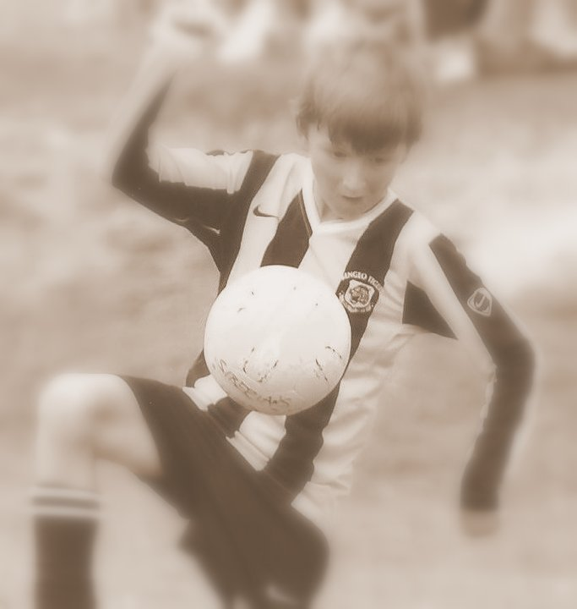
Bengeo Tigers Football Club Parents & Supporters

Slide 2
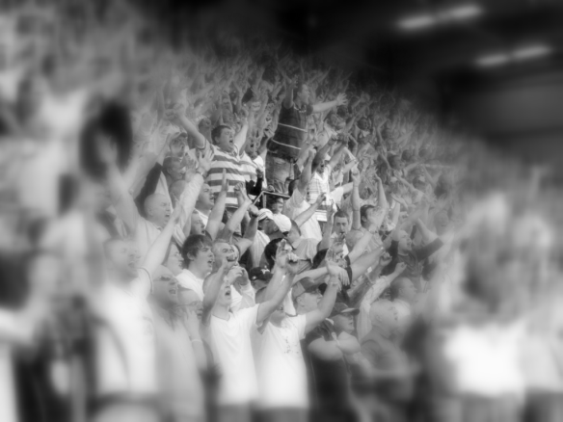
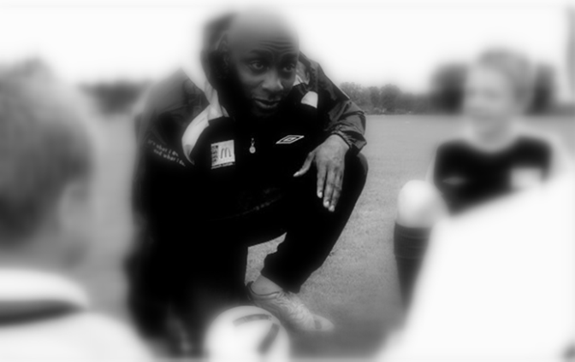
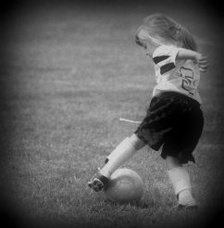
The Roles of Supporters, Coaches and Players at BTFC
Parents and Supporters ‘support’
Coaches ‘coach’
Players ‘play’

Slide 3
Children aren’t Perfect; Nobody’s Perfect
Football is a game that children want to ‘play’. We want all players to have touches of the ball and have the freedom to explore, express themselves and be creative.
It is vital that children are allowed to enjoy their football and not be negatively criticized for mistakes.
Coaches and parents must see mistakes as learning opportunities. Children by their very nature can be inconsistent and random in their actions, so it should not be a surprise when mistakes are made, particularly when learning new skills

Slide 4
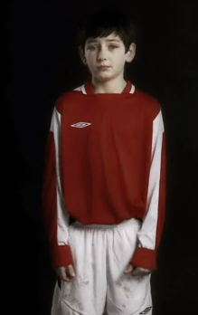
BTFC and Respect It’s NOT Optional
When Parents sign their child to BTFC they acknowledge that they agree to abide by the parents/spectators code of conduct.
This code of conduct is not optional. We have this for a reason.
Watch the following videos on why our code of conduct is so important:
Parents and Carers guide - Scene1
http://www.youtube.com/watch?feature=endscreen&v=61-Pax5cF8A&NR=1
Parents and Carers guide - Scene2
http://www.youtube.com/watch?v=ZRcv-ZRMCXI&feature=relmfu
Parents and Carers guide - Scene3
http://www.youtube.com/watch?v=86LmKa1Sig4&feature=relmfu
Parents and Carers guide - Scene4
http://www.youtube.com/watch?v=lOf81jcqyYc&feature=relmfu
The Childs view
http://www.youtube.com/watch?v=q2VcHmZS0cA&feature=relmfu

Slide 5
So what can a BTFC Parent/Supporter do to help their Child?
Parents following the code of conduct are directly influencing their child’s development by allowing them the freedom to enjoy and develop their football without fear.
A player who plays without fear will improve simply by wanting to play. A frightened player will just want to stop and go home.
It is rare for any great player to have been successful without a supportive family. However many players never have the chance to fulfil their potential by quitting due to parental pressures.
So support your child, the team and the game.

